Slide 1
Towards Robust Image Steganography
.
Presented by :
Sivangula Narendra(Y20IT112)
Shaik Arshad Ayub(Y20IT103)
Shaik Meera Hussain(Y20IT106)
Guided By :
Dr.B.Hemanth Kumar

Slide 2
CONTENTS
1. PROBLEM STATEMENT
2. PROPOSED METHOD
3. BLOCK DIAGRAM
4. PROPOSED METHOD ALGORITHMS
5. RESULTS & DISCUSSIONS
6. CONCLUSION
7. REFERENCES

Slide 3
PROBLEM STATEMENT
Existing Steganographic methods are not that much efficient for Embedding the secret data into media files. This is because the secret data can be easily detected using Steganalysis Tools.
The main aim is to embed information inorder to avoid the detectability of the secret information. For achieving this the paper proposes an efficient way that is Compression, followed by data embedding using Universal Wavelet Relative Distortion (UNIWARD) and Uniform Embedding Revisited Distortion (UERD). After that coefficient adjustment is performed on original image based on stego image.

Slide 4
PROPOSED METHOD
Robust Image Steganography: It is a novel image steganography frame work which is useful for transmitting secret information through the image files. This frame work is especially robust incase of JPEG images. This frame work involves Compression followed by Data Embedding which results a stego image which is non detectable.
The performance of the proposed frame work is robust due to its non detectable nature of information hidden in the image files. This frame work is also useful for working with other type of images.

Slide 5
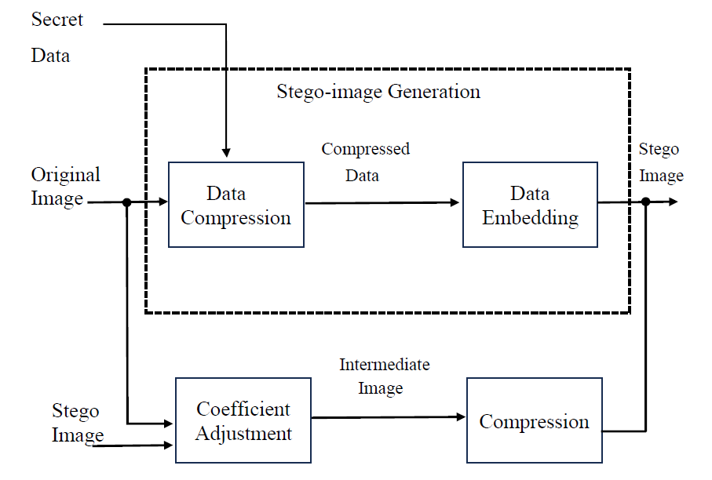
BLOCK DIAGRAM

Slide 6
PROPOSED METHOD ALGORITHM
Stego Image Generation:
First we will take the Secret Data as input and perform the compression.
After that we will get the compressed Data as output.
Next we will embed the data into the image using any of the two steganography schemes i.e., UNIWARD or UERD.

Slide 7
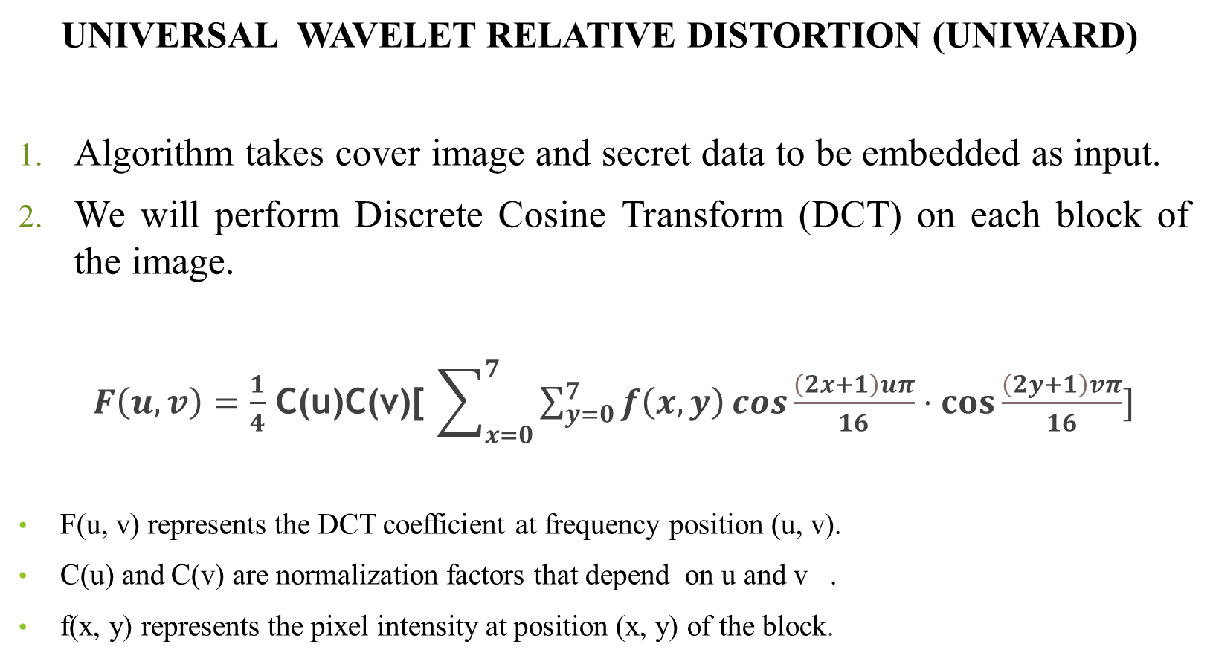
UNIVERSAL WAVELET RELATIVE DISTORTION (UNIWARD)
Algorithm takes cover image and secret data to be embedded as input.
We will perform Discrete Cosine Transform (DCT) on each block of the image.
$F\left(u,v\right)=\frac{1}{4}$ C(u)C(v)[ $\sum_{x=0}^{7}{\sum_{y=0}^{7}{f\left(x,y\right)}}\cos{\frac{\left(2x+1\right)uπ}{16}}⋅\cos{\frac{\left(2y+1\right)vπ}{16}}]$
F(u, v) represents the DCT coefficient at frequency position (u, v).
C(u) and C(v) are normalization factors that depend on u and v .
f(x, y) represents the pixel intensity at position (x, y) of the block.

Slide 8
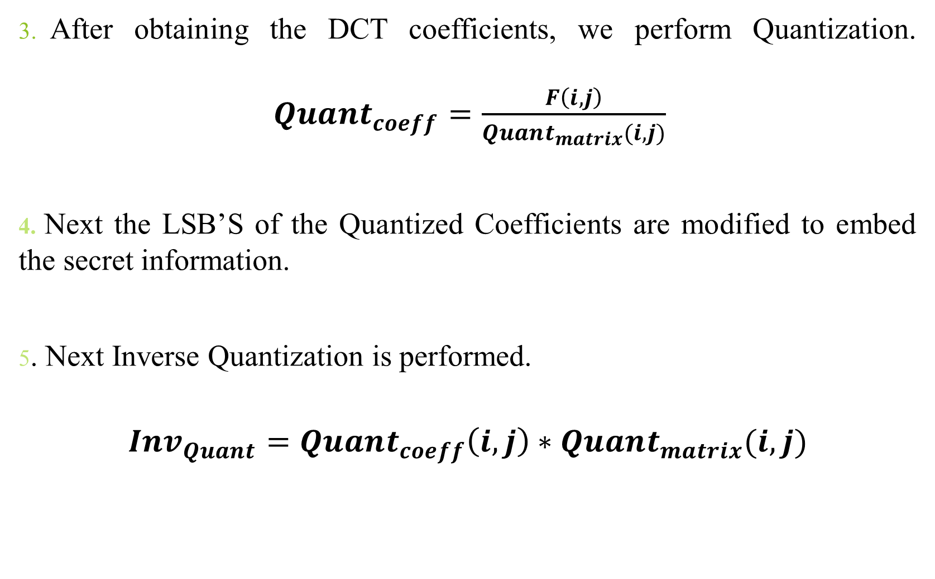
After obtaining the DCT coefficients, we perform Quantization. $Qua{nt}_{coeff}=\frac{F\left(i,j\right)}{Quant_{matrix}(i,j)}$
4. Next the LSB’S of the Quantized Coefficients are modified to embed the secret information.
5. Next Inverse Quantization is performed.
$$Inv_{Quant}=Quant_{coeff}\left(i,j\right)∗Quant_{matrix}(i,j)$$

Slide 9
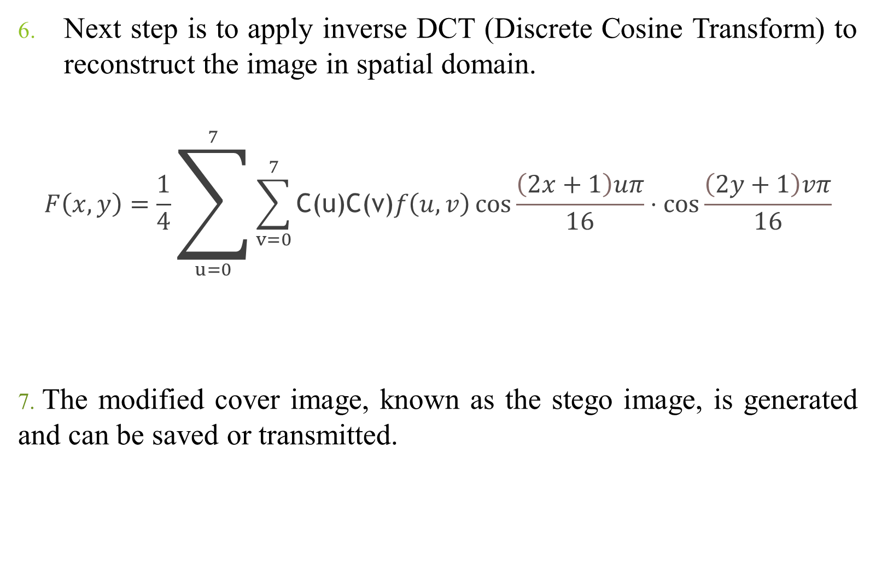
Next step is to apply inverse DCT (Discrete Cosine Transform) to reconstruct the image in spatial domain.
$$F\left(x,y\right)=\frac{1}{4}\sum_{u=0}^{7}{\sum_{v=0}^{7}{\text{C}\text{(}\text{u}\text{)}\text{C}\text{(}\text{v}\text{)}f\left(u,v\right)}}\cos{\frac{\left(2x+1\right)uπ}{16}}⋅\cos{\frac{\left(2y+1\right)vπ}{16}}$$
7. The modified cover image, known as the stego image, is generated and can be saved or transmitted.

Slide 10
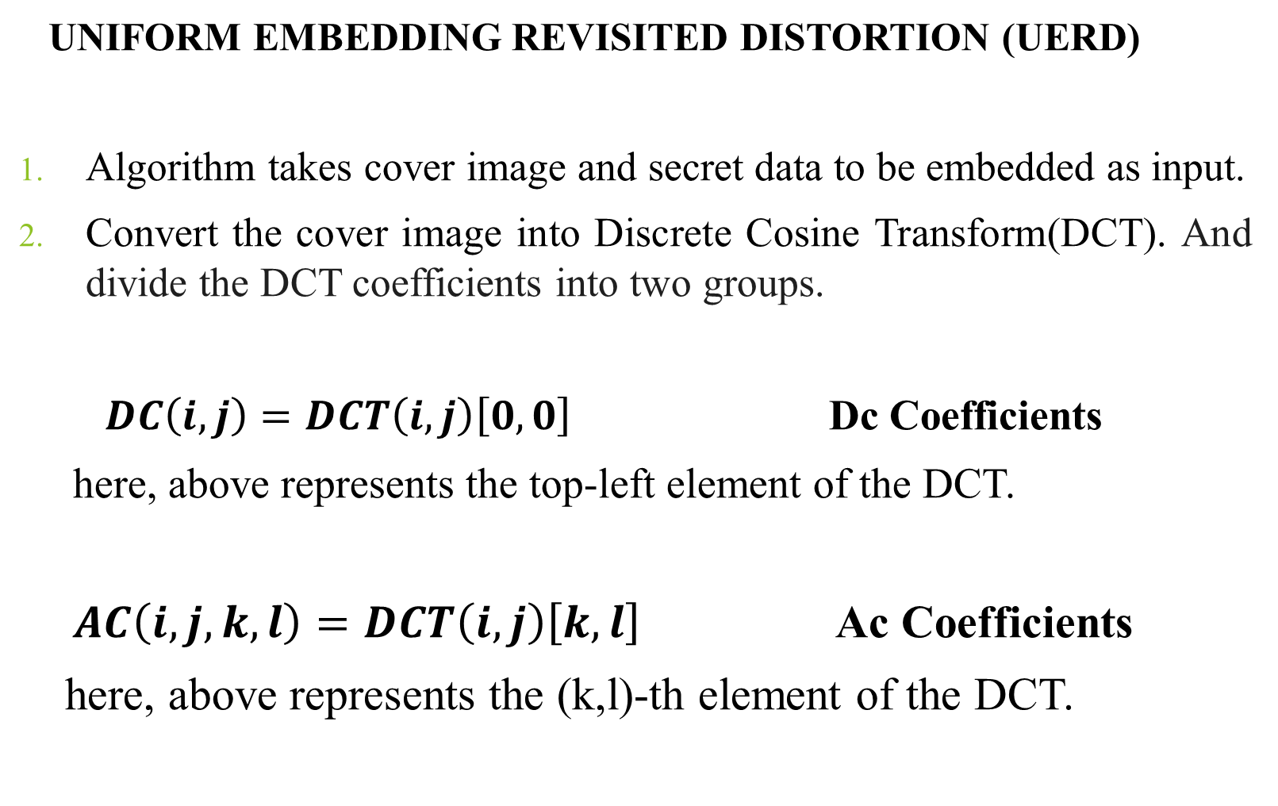
UNIFORM EMBEDDING REVISITED DISTORTION (UERD)
Algorithm takes cover image and secret data to be embedded as input.
Convert the cover image into Discrete Cosine Transform(DCT). And divide the DCT coefficients into two groups.
$DC\left(i,j\right)=DCT\left(i,j\right)\left[0,0\right]$ Dc Coefficients
here, above represents the top-left element of the DCT.
$AC\left(i,j,k,l\right)=DCT\left(i,j\right)\left[k,l\right]$ Ac Coefficients
here, above represents the (k,l)-th element of the DCT.

Slide 11
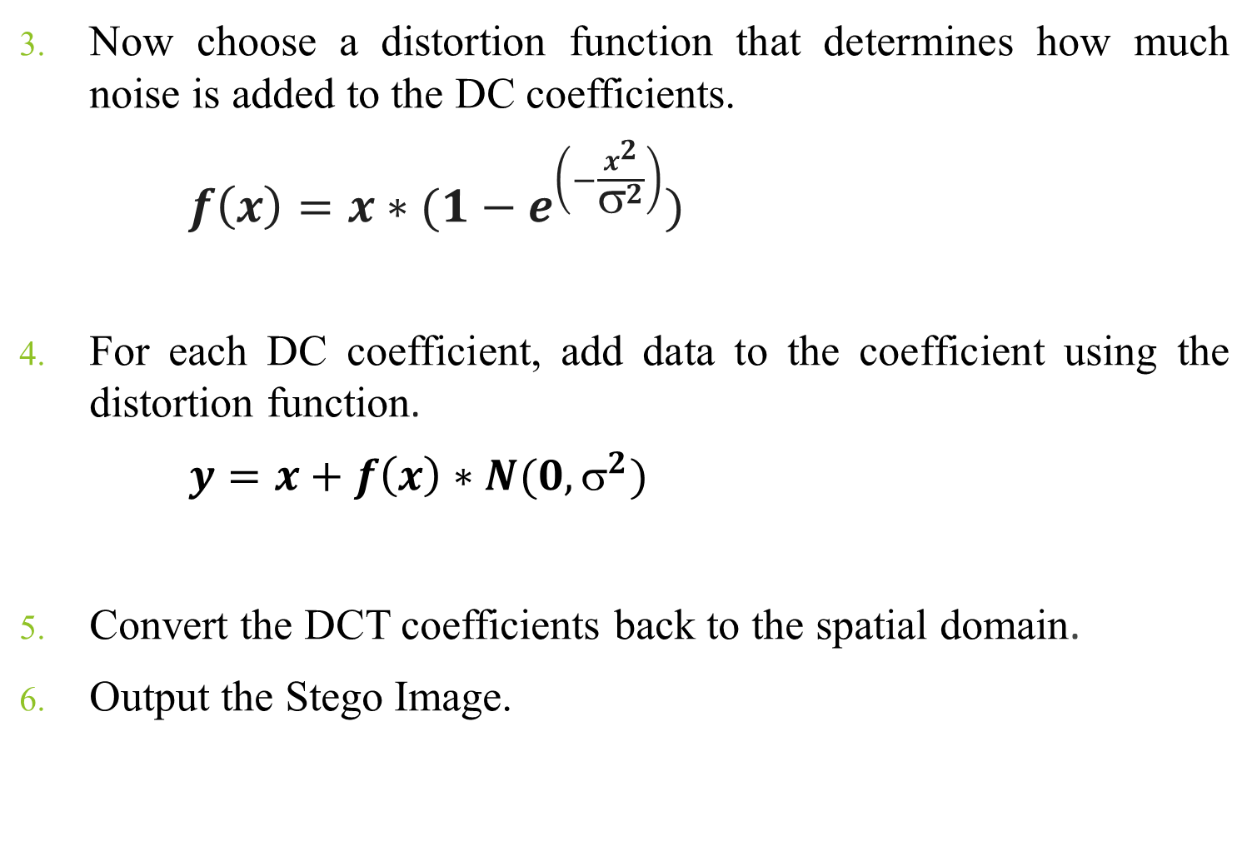
Now choose a distortion function that determines how much noise is added to the DC coefficients.
$f\left(x\right)=x∗(1−e^{\left(−\frac{x^{2}}{σ^{2}}\right)})$
For each DC coefficient, add data to the coefficient using the distortion function.
$y=x+f\left(x\right)∗N(0, σ^{2})$
Convert the DCT coefficients back to the spatial domain.
Output the Stego Image.

Slide 12

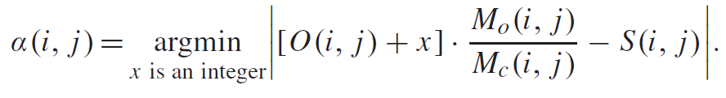
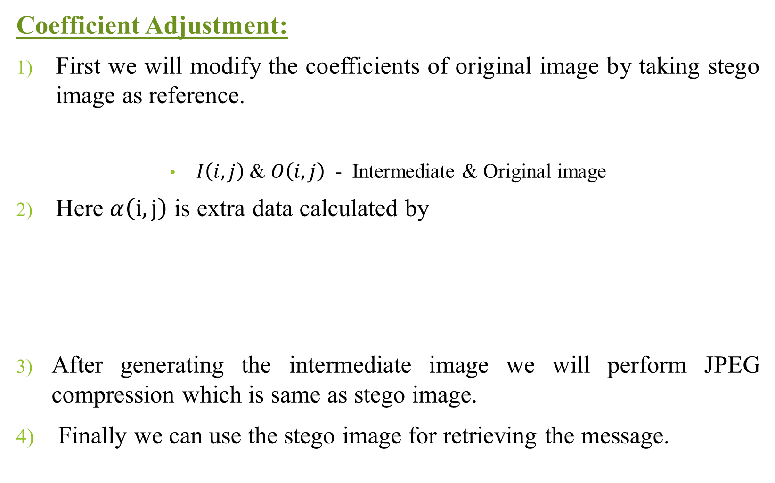
Coefficient Adjustment:
First we will modify the coefficients of original image by taking stego image as reference.
$I\left(i,j\right)$ & $O\left(i,j\right)$ - Intermediate & Original image
Here $α\left(i,j\right)$ is extra data calculated by
After generating the intermediate image we will perform JPEG compression which is same as stego image.
Finally we can use the stego image for retrieving the message.

Slide 13
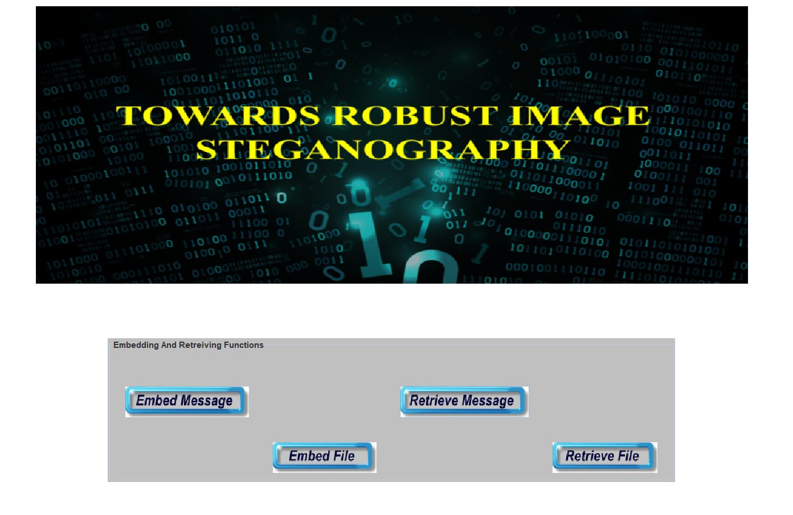
RESULTS & DISCUSSIONS

Slide 14
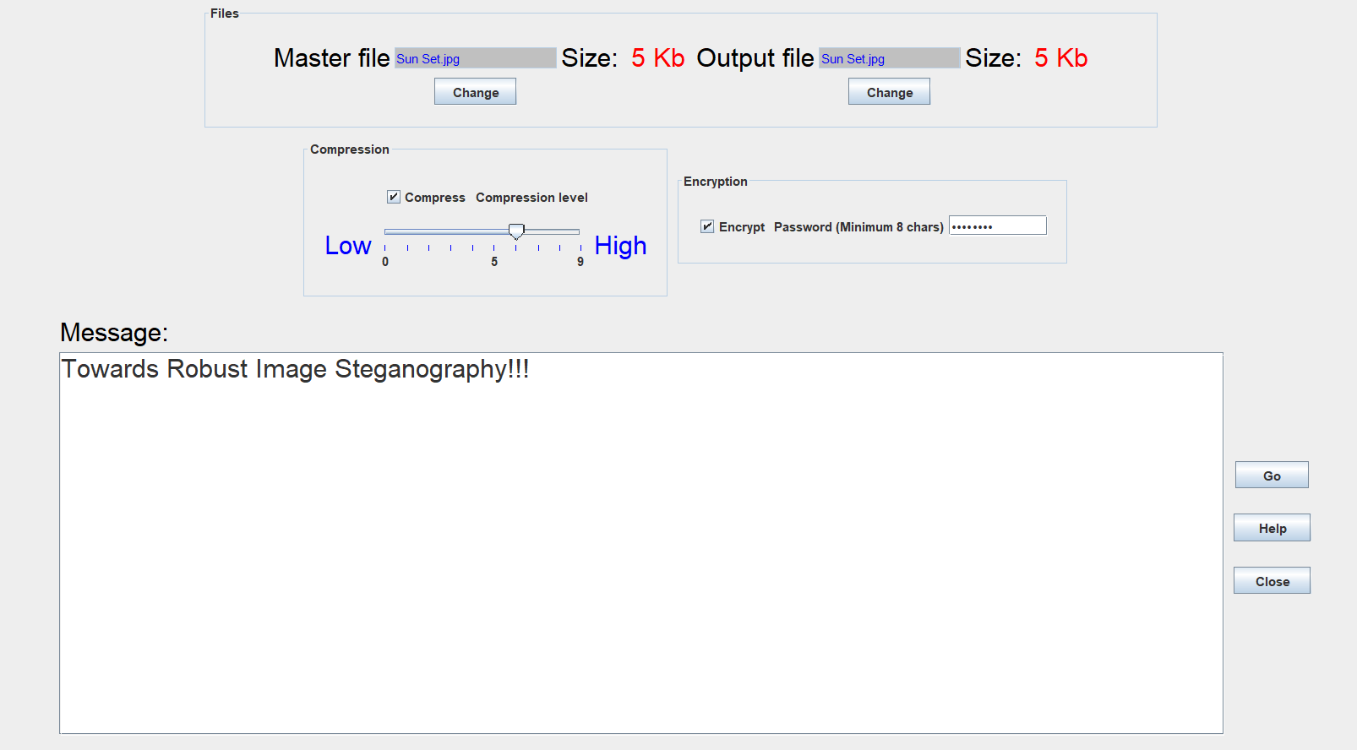
Embedding Message Into The Image

Slide 15
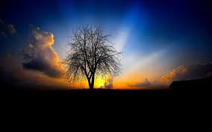
Original Image (5761 Bytes) Stego Image ( 5937 Bytes)

Slide 16
Retrieving Message From Stego Image

Slide 17
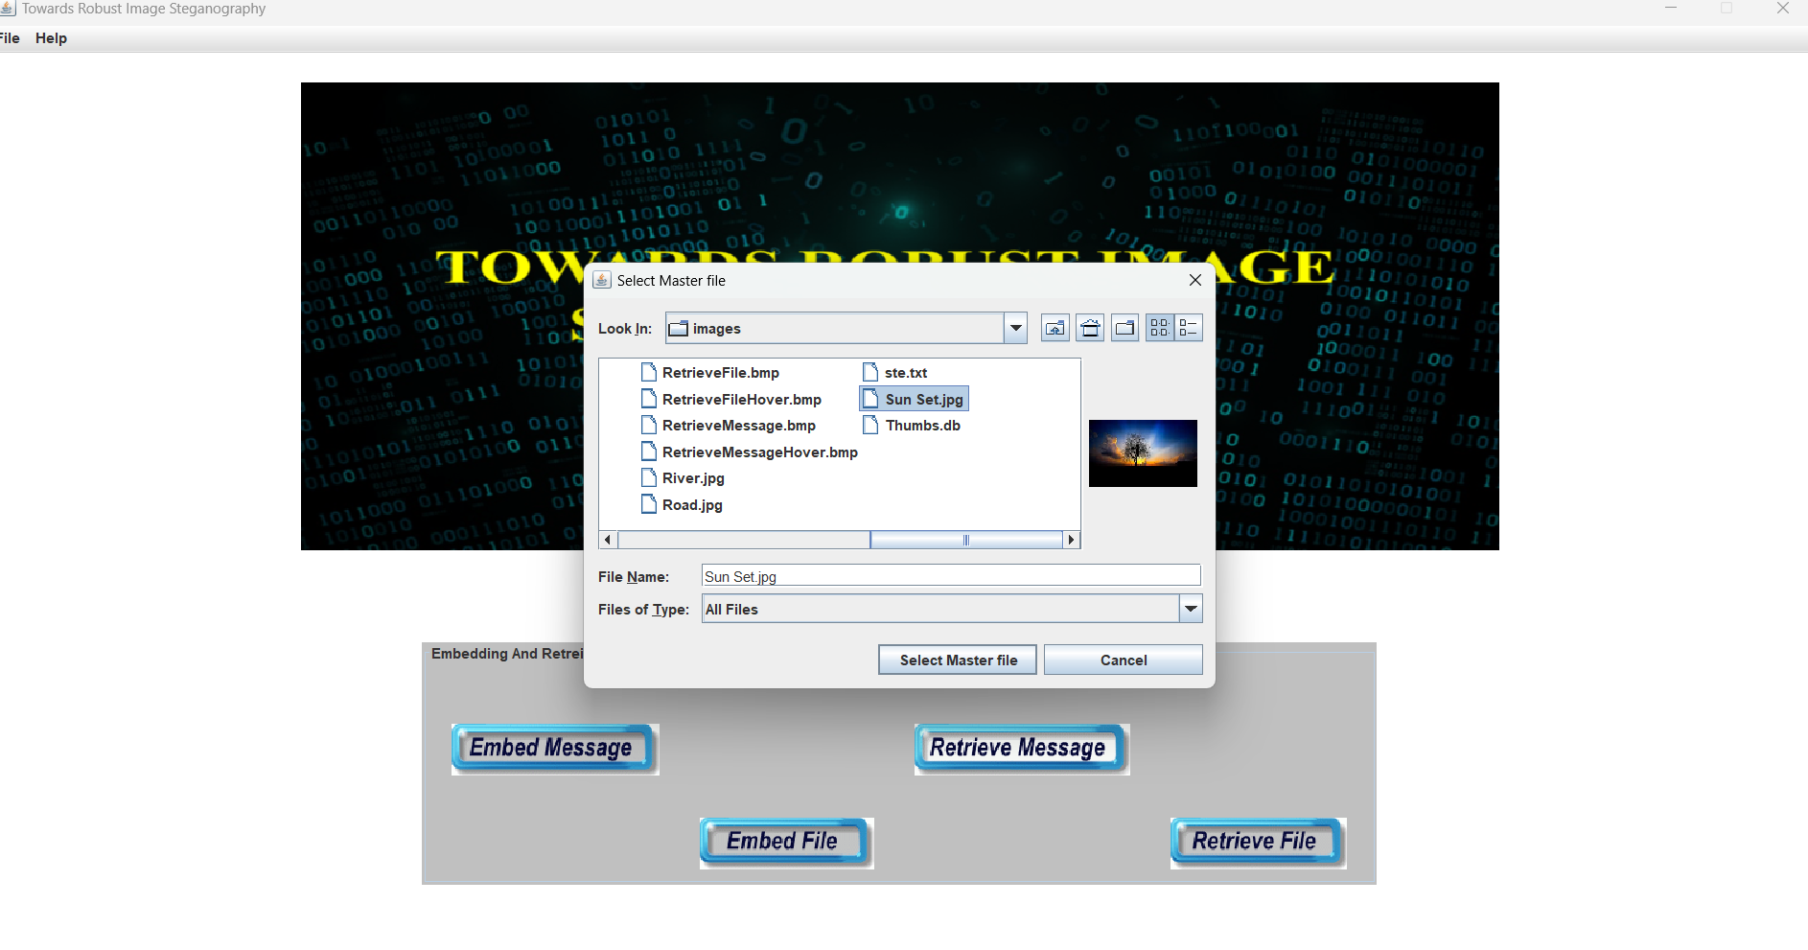
Selecting The Stego Image

Slide 18
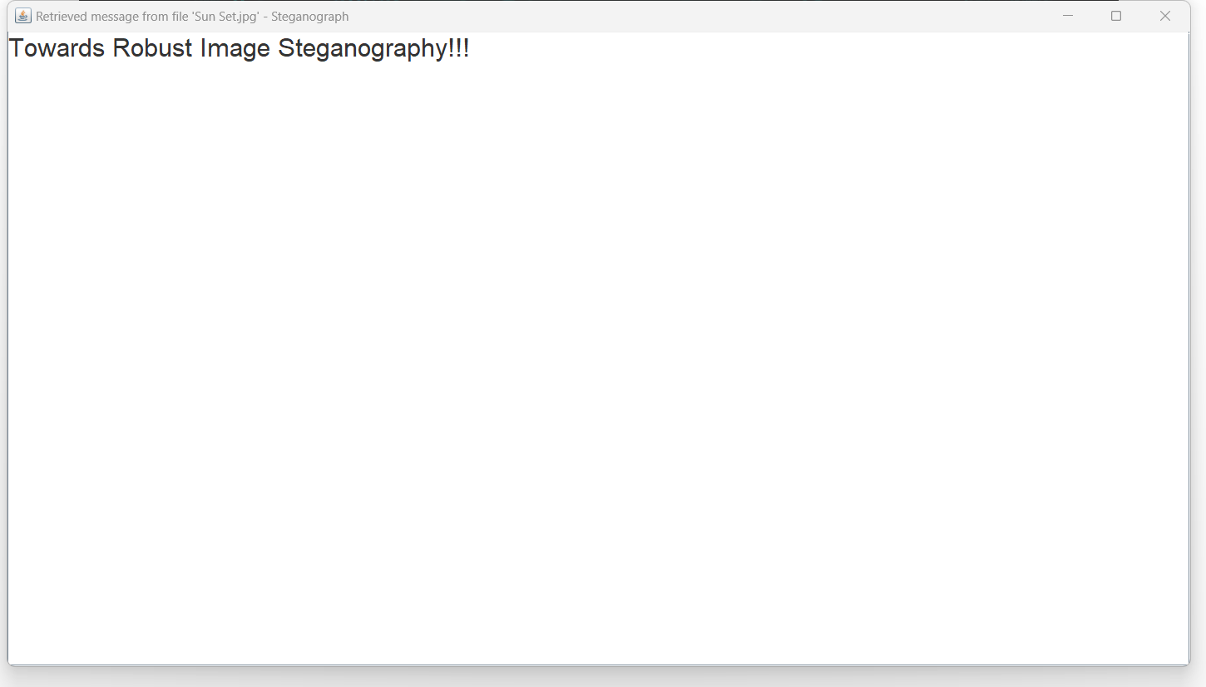
Retrieved Message

Slide 19
CONCLUSION
A novel framework for robust image steganography is proposed, which is able to resist the Data compression of the communication channel. In this framework, first stego-image is obtained by embedding the compressed data into the image using any of the existing JPEG steganographic schemes.
Therefore, it is guaranteed that the secret data can be recovered from our stego-image with 100% accuracy.

Slide 20
REFERENCES
A. Westfeld, “F5-a steganographic algorithm,” in Proc. Int. Workshop Inf. hiding. Springer, 2001, pp. 289–302.
X. Zhang and S. Wang, “Efficient steganographic embedding by exploiting modification direction,” IEEE Commun. Lett., vol. 10, no. 11,2006.
H. Wu and J. Huang, “Secure JPEG steganography by LSB+ matching and multi-band embedding,” in Proc. IEEE Int. Conf. Image Process.,2011, pp. 2737–2740.

Slide 21
REFERENCES
V. Holub, J. Fridrich, and T. Denemark, “Universal distortion function for steganography in an arbitrary domain,” EURASIP J. Inf. Secur., vol. 2014.
L. Guo, J. Ni, W. Su, C. Tang, and Y.-Q. Shi, “Using statistical image model for JPEG steganography: Uniform embedding revisited,” IEEE Trans. Inf. Forensics Security, vol. 10, no. 12, pp. 2669–2680, Dec. 2015.
Y. Zhang, X. Zhu, C. Qin, C. Yang, and X. Luo, “Dither modulation based adaptive steganography resisting JPEG compression and statistic detection,” Multimedia Tools Appl., vol. 77, no. 14, pp. 17913–17935, 2017.

Slide 22
THANK YOU

